Slide 1
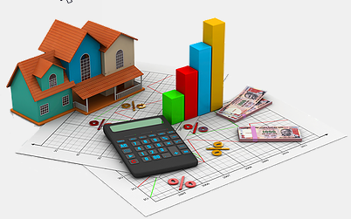
HOUSING: PRICE PREDICTION
Name:
Chaitali Nakade

Slide 2

Agenda
Introduction
Problem statement
Tools used
About dataset
Data sources and there format
Data preprocessing
Outlier and skewness removal
Model building
Select best model
Hyperparameter tuning
Boosting model
conclusion

Slide 3
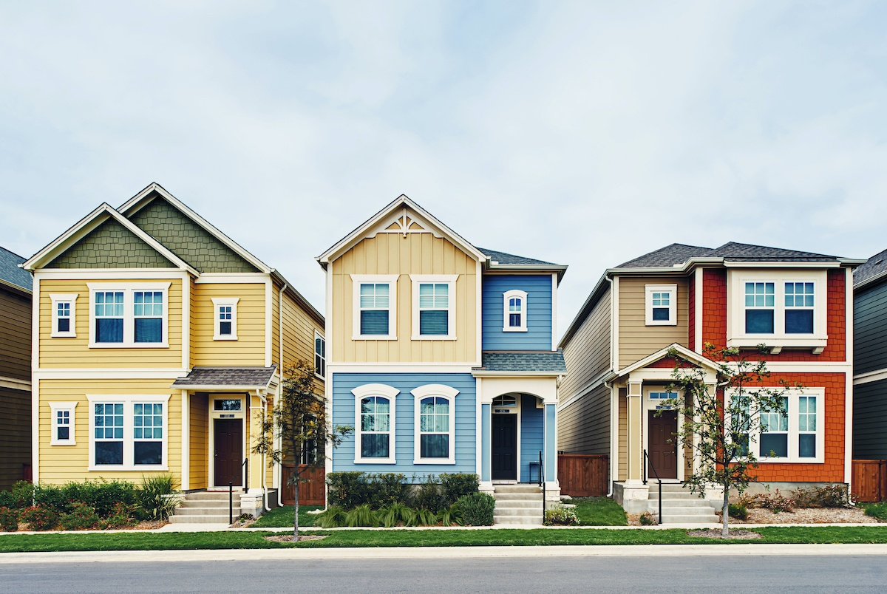
Introduction
The population of world is increasing day by day and the demand for residence remains unmet as per the requirement because lack of houses present in the market.
Houses are one of the necessary needs of each and every person around the globe and therefore housing and real estate market is one of the markets are getting expanded.
Built a model with supervised machine learning technique and predict the selling price of houses.

Slide 4
Problem statement
A US-based housing company named Surprise Housing has decided to enter the Australian market.
The company uses data analytics to purchase houses at a price below their actual values and flip them at a higher price.
Build a model using Machine Learning in order to predict the sale price of the prospective properties and decide whether to invest in them or not.
There are so many factors which affects the prices of houses like location, locality, zone, building type and many more.

Slide 5

Tools used
Hardware and Software Requirements and Tools Used
Notebook and Data:
GitHub, Jupyter Notebook
Libraries:
Numpy
Pandas
Sklearn
Scipy
Joblib
Matplotlib
Seaborn
statsmodels

Slide 6
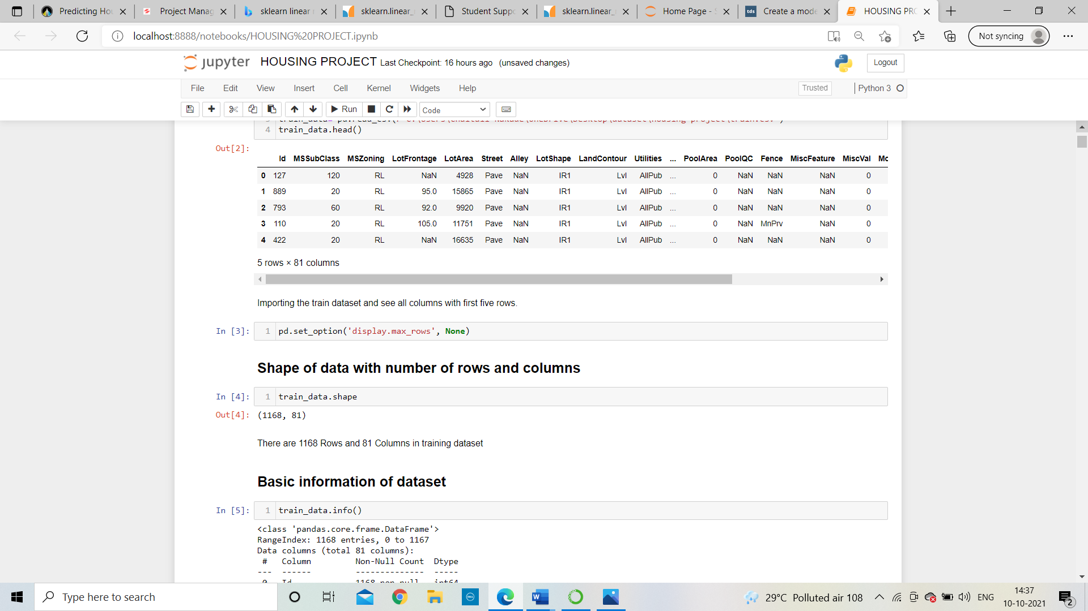
About dataset
we are having two dataset and that are train and test dataset.
The train dataset contains 1168 rows 81 columns and test dataset contain 292 rows and 80 columns.
Importing necessary libraries
After importing dataset the dataset will be

Slide 7
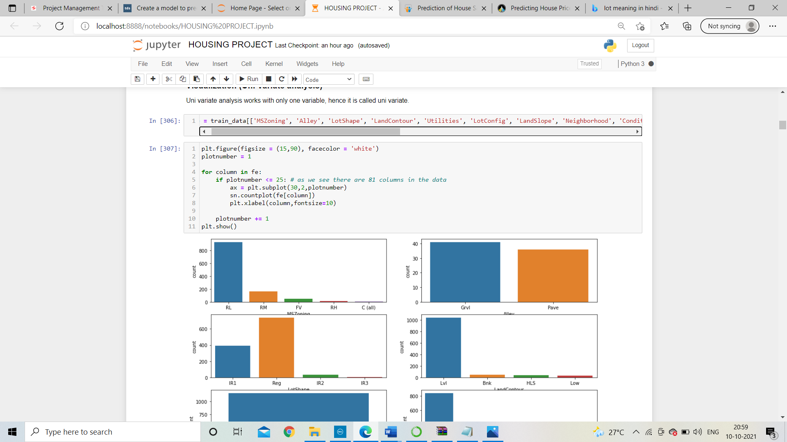
Data sources and there format
There are 1168 Rows and 81 Columns in training dataset
We can see some columns are having null values also.
We can find here only three columns are having floating data types, 35 columns are having integer datatype and other 43 columns are having object data type.
In which zone most commonly houses are sold?
Residential in Low-Density houses are most commonly sold

Slide 8
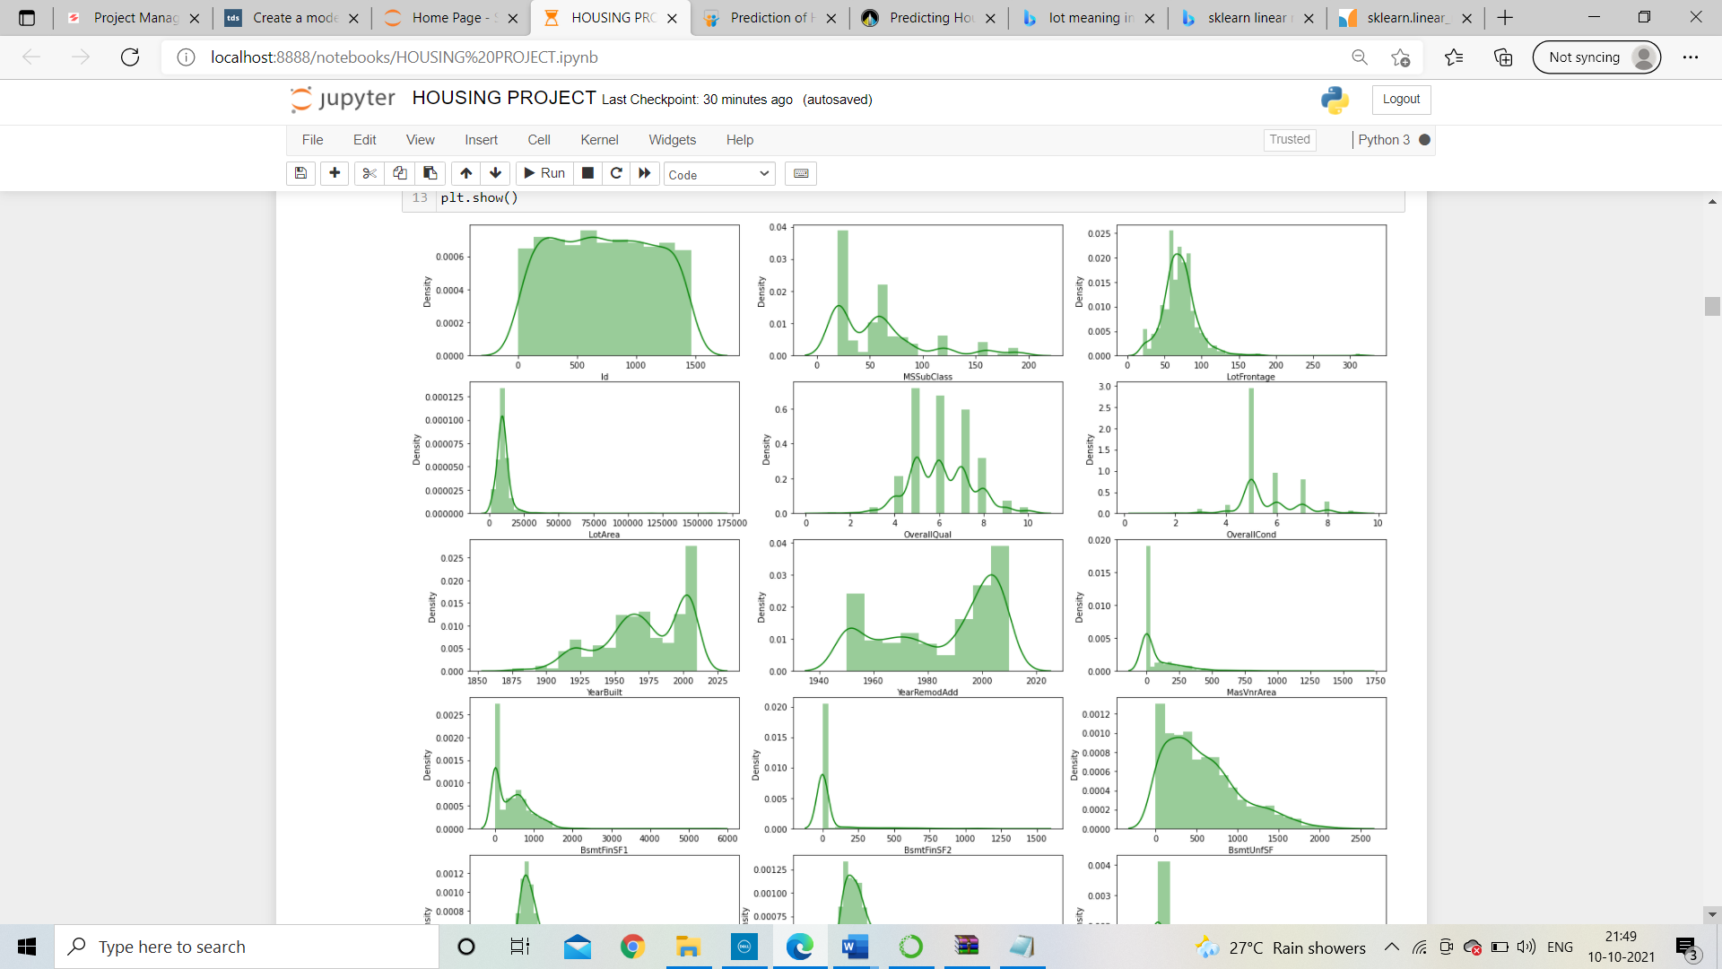
Data sources and there format continue
For a builder having this data, He can make a new construction in Residential with Low-Density to fascinate more buyers
Most important factor for sale price?
Depends on quality of houses the houses are sold
overall quality of houses is pick with 5 rating followed by 6 and 7 most commonly sold.
rating with 3 and 10 are least soled houses

Slide 9
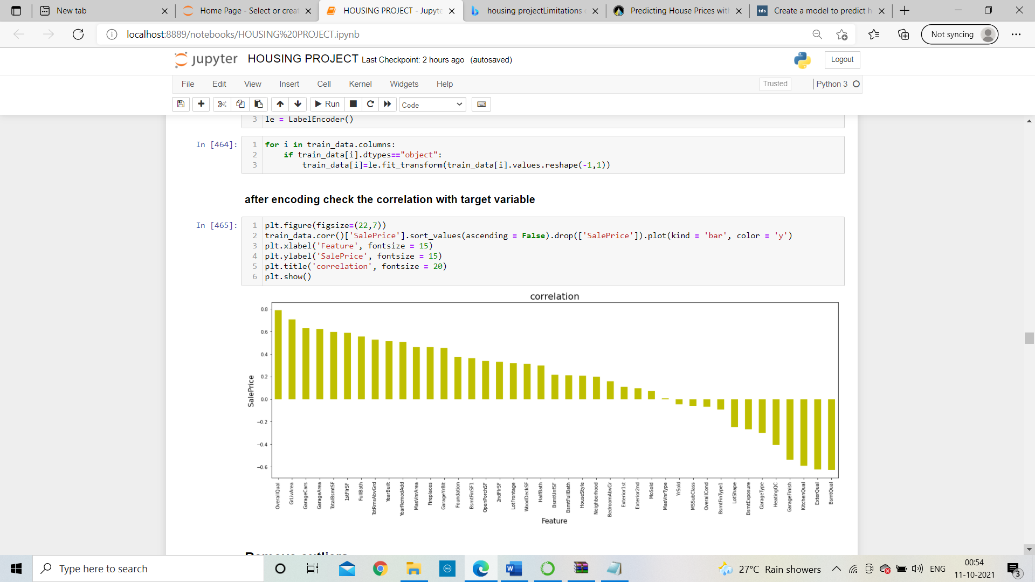
Data sources and there format continue
Correlation with saleprice?
Overall quality is positively correlate with sale price
it is an important variable to predict the saleprice.

Slide 10
Data preprocessing
Block diagram of data pre-processing
1. Drop unnecessary columns
2. Filling missing value
3. Encode the object datatype
4. Outlier detection
5. Skewness removal

Slide 11
Outlier and skewness removal
With mean/median and mode solve the problem of missing values
Drop that columns which are having poor correlation with target variable.
Encode the object datatypes columns with label encoder.
Use that technique outlier removal technique through which less data will be loss.
I had use z score technique
For continuous columns which are having skewness value greater than +0.5 to -0.5 then it is important to remove skewness from that.
Method used : yeo_johnson

Slide 12
Model building
find the best random state
Split the train_data into train
Test split
Build a model with different
Algorithms
Find Accuracy of model ( r2
Score)
Check model is overfitted or
Not through CV score
Find best random state
Train test split
Model building
R2 score
Cross validation score

Slide 13
Select best model
Comparison of models
Linear regression model is having minimum difference between cross validation score and r2 score, so Linear regression is a best model
Sr. No. | Algorithms | Accuracy score (a) | Cross -Validation Score(b) | Difference (a-b)
1. | Linear Regression | 86.44% | 85.01% | 1.43 %
2. | Random forest regressor | 88.40% | 84.50% | 3.8 %

Slide 14
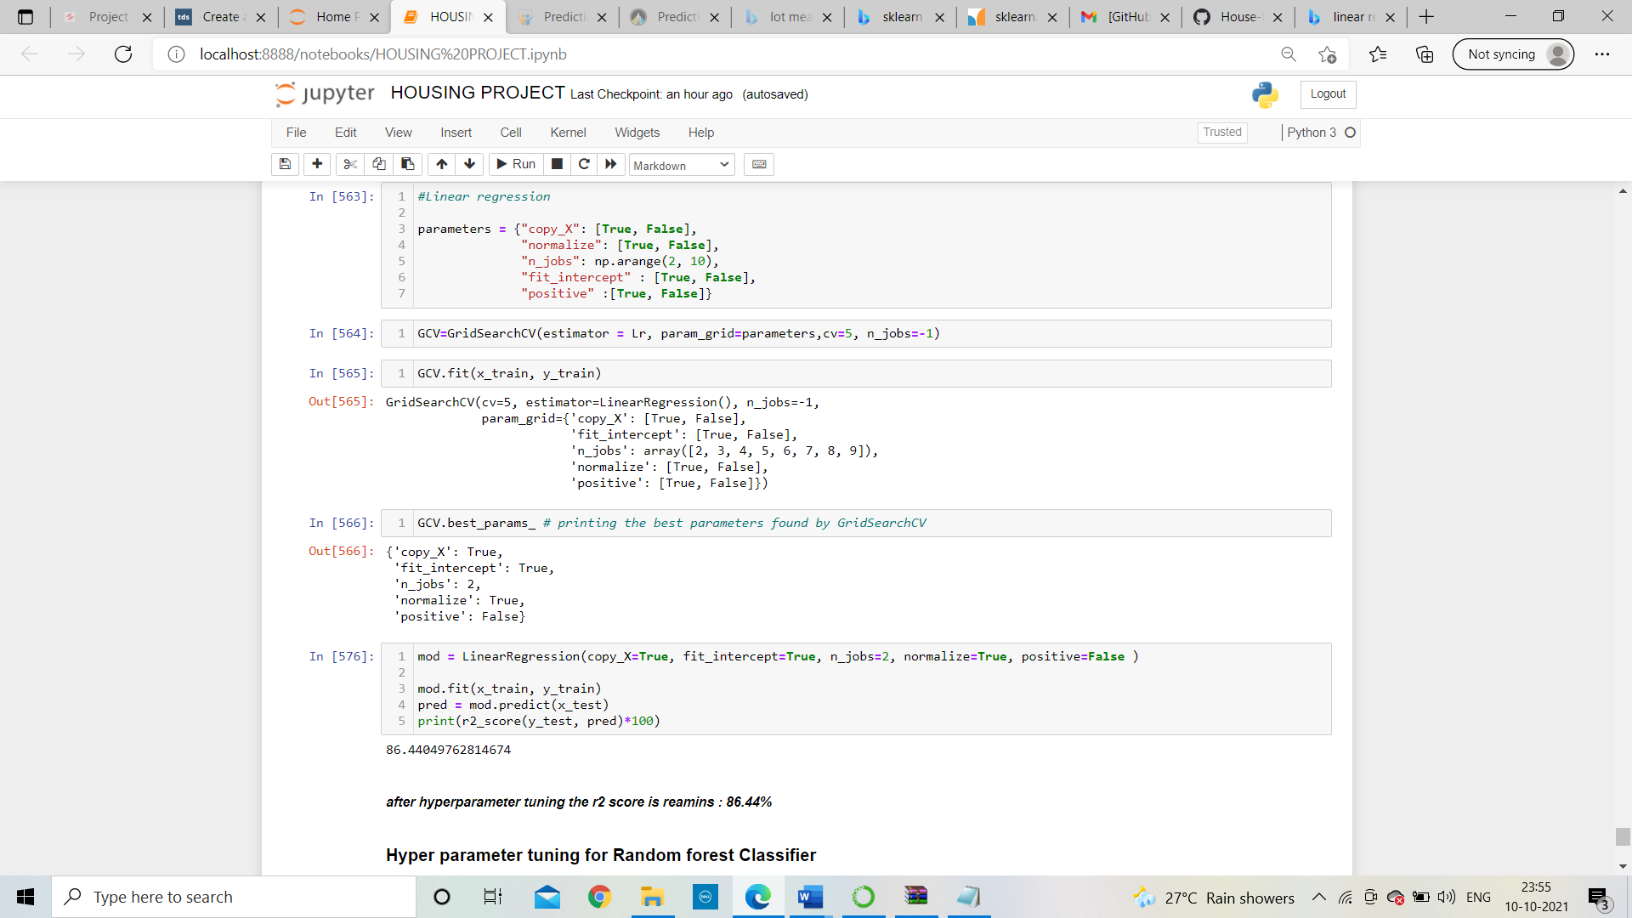
Hyperparameter tuning
Grid search cross validation (GCV) in hyperparameter tuning will help us to finding the best parameter and tune it with training data set and give best r2 score
After hyperparameter tuning the r2 score is remains: 86.44%

Slide 15
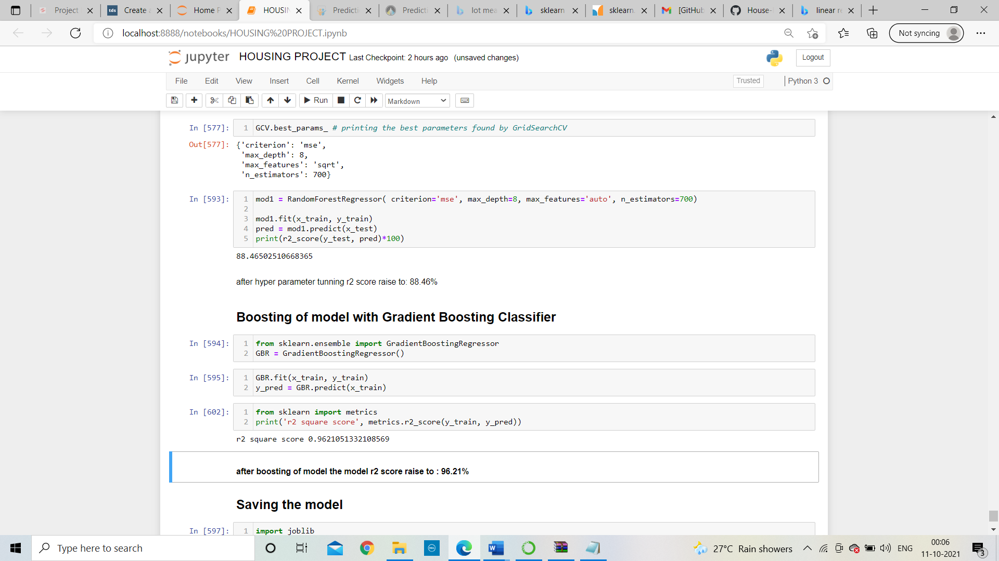
Boosting model
With the help of Gradient Boosting Regressor, boost the model and then r2 score raise to
We got an accuracy of 96.21%
Save the model

Slide 16
Conclusion
Overall Quality is highly correlated with target variable i. e. Sale Price
If the quality of house increases than selling price will also be increased.
We fit our training data into the gradient boosting model and check for accuracy
We got an accuracy of 96.21% which is amazing

Slide 17
THANK YOU

